Slide 1
04.28.16
BUILDING
PROVIDER RELATIONSHIPS

Slide 2
SUMMARY
How to build provider relationships
How to learn what providers want
Engaging others to assist you
Measuring Success – Examples

Slide 3
BUILDING BLOCKS
Leadership
Goals
Strengths/Weaknesses
Engagement
Education
Surveys
Examples
Toolkit

Slide 4
LEADERSHIP
Gaining support from health facility leaders and providers is key to building relationships
Identify goals
Set Timelines
Measuring Success
Follow up
Notes:
The third option is a healthy medium between the first two text-only layouts. Here you have a short summary or build up to the list that follows. Instead of bullets this list uses color coordinating arrows that can be copied and applied to other slides if desired. (Right click the arrow, select copy. Then right click on the slide in which you want to place the arrow and select paste. The arrow will paste to the new slide in the same position it was in on the previous slide.)

Slide 5
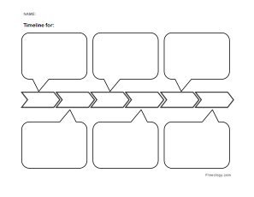
TIMELINE
Develop realistic timeline – adjust as needed
Check your status on goals at regular intervals
Communicate progress monthly
CELEBRATE MILESTONES!

Slide 6
GOALS
Know your providers.
One on one meetings with providers - to assess their needs and identify strengths and weaknesses of your organization
Survey providers
Develop list of top priorities
Build your team

Slide 7
Action Packed Visits
Ask what the provider needs from your organization, do they refer or admit to your facilitiy
Concerns
CME opportunities
Protocol sharing
Opportunities to visit your organization
Bring directory of your medical staff and services with contact numbers
Ask to meet front-line staff and address their concerns
Ask for the opportunity to return and let them know you are willing to help them when they are trying to access your organization

Slide 8
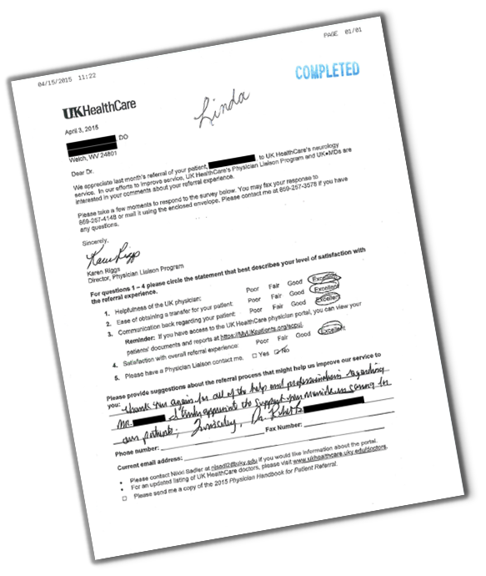
SURVEY OF PROVIDERS
Satisfaction
About admission or referral process
Communication
Overall care of patient

Slide 9
ENGAGEMENT
Engage others throughout your organization in order to bring about positive changes:
Admissions – referring and primary provider
Call Center – ability to contact providers
Medical Records/IT – improving communication

Slide 10
ENGAGING PEDIATRICIANS
Building relationships with Non-KCH Pediatricians
Roundtable quarterly dinners to discuss specialty areas with pediatricians in the community
Ease of referring
Discharge instructions
Follow-up care
Communication
Sharing protocols
Community Relations Pediatrician position created
Bi-Annual Community Wide Morning Report – Case Review
Pediatric list-serve to share educational information and introduction to new providers within Kentucky Children’s Hospital

Slide 11
EXAMPLE – KCH
Building relationships with Non-KCH Pediatricians
Roundtable quarterly dinners to discuss specialty areas with pediatricians in the community
Ease of referring
Discharge instructions
Follow-up care
Communication
Sharing protocols
Community Relations Pediatrician position created
Bi-Annual Community Wide Morning Report – Case Review
Pediatric list-serve to share educational information and introduction to new providers within Kentucky Children’s Hospital
Always have your toolkit ready!

Slide 12
EDUCATIONAL PROGRAMS
CANCER
Colorectal
Endometrial
Ovarian
Breast
Stereotactic Radiosurgery
Lung
CARDIOLOGY, CT SURGERY AND TRANSPLANTATION
Advanced Heart Failure and LVAD Heart Disease
AFIB
STEMI
Pulmonary Hypertension
Adult ECMO
ED
Pelvic Trauma
Pediatric Trauma – Golden Hour
Resuscitation and Intubation
Identifying Shaken Baby Syndrome
PEDIATRICS
Community Acquired MRSA
Pediatric Sepsis
Treatment of Pediatric Asthma
Child Abuse
Endocrinology
Pediatric ECHO
NEUROLOGY AND NEUROSURGERY
Acute Stroke Update

Slide 13
GROWING – VASCULAR SURGERY
GROWING VASCULAR SURGERY
Goals
Increase identification of peripheral arterial (PAD) disease risk in the primary care and cardiology setting
Develop simple patient self-screening tool to identify risk with MD input
Increase use of non-invasive testing for high risk patients
Grow PAD procedures and surgeries
Grow public awareness
Tactics
Test self-screening tool in community setting
Promote screening tool
Physicians evaluate patient’s risk assessment and need for additional testing
Developed simple referral options for patients needing intervention
Grow public awareness through community health fairs, educational talks, web information, flyers
Outreach (example) with vascular surgeons to meet potential referring physicians

Slide 14
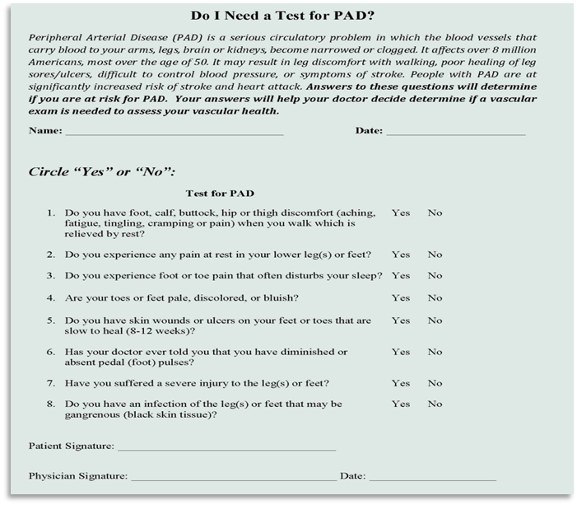
SELF ASSESMENT FOR PAD
Introduce form to PCPs for use in waiting room
Patient fills out while waiting to be called back
PCP refers patients to vascular surgeon as needed for consultation

Slide 15
EDUCATION
CME or Non-CME – providers, nursing, first responders
Engage medical staff to present on their area of specialty to small groups or large
Involve nursing

Slide 16
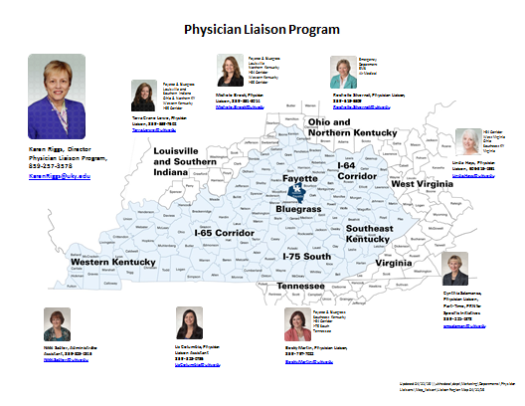
PHYSICIAN LIAISONS

Slide 17
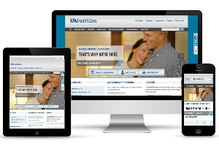
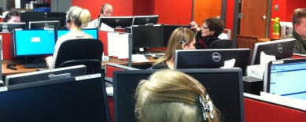
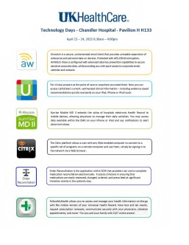
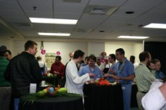
TOOLS
Karen Riggs
Director
Nikki Sadler
Program Admin Support
Tarra Crane Lowe
Northern & W KY
Linda Hays, RN
Eastern KY
Rebecca Martin
12/15/14
Southern Region
Rochelle Silvernail
EMS/Hospital
Liz Columbia
Liaison Support
Michele Brock
I 65

Slide 18
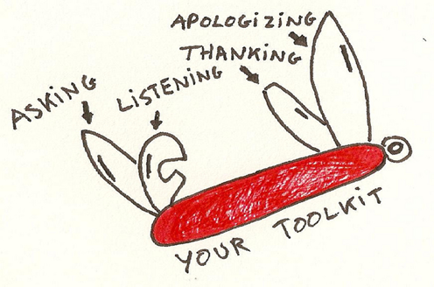
TOOLKIT
Always have your toolkit ready!
Leadership support is helpful when building relationships with providers.

Slide 19
QUESTIONS & DISCUSSION

